Slide 1


2020
企业及产品介绍
Company and Product Introductions

Slide 2

01
企业介绍
Company Profile
目录
02
资质证照-国内证照
CONTENTS
Qualification Certificate
03
资质证照-出口资质
Qualification Certificate
04
产品及包装展示
Products & Packaging

Slide 3

01
企业介绍
Company Profile
PART ONE

Slide 4
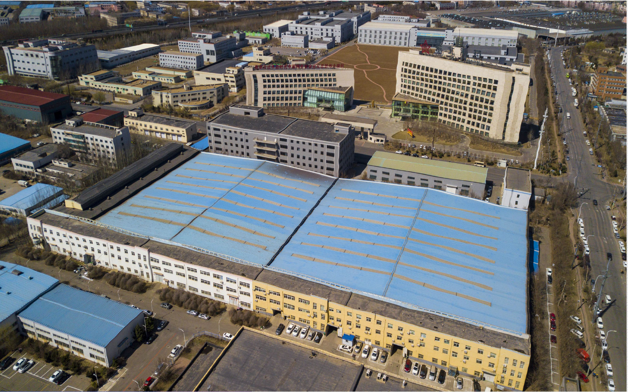
01
公司简介
COMPANY PROFILE
企业介绍
沈阳盛实医疗科技有限公司专业从事国内医疗器械研发、生产及新技术的转化和引进。
Shenyang Shengshi Medical Technology Co., Ltd. specializes in domestic medical device research & development, production, transformation & introduction of new technologies.
公司成立于2014年，注册资本2200万人民币，占地面积近7500平方米，其中十万级洁净区约1000平方米；生产地址位于辽宁省沈阳市经济技术开发区。
The company was established in 2014 with a registered capital of 22 million yuan (RMB), which covers an area of ​​nearly 7,500 square meters, including 1,000 square meters Class 100,000 clean area.
沈阳盛实医疗科技有限公司
梦想
诚信
品质
务实

Slide 5
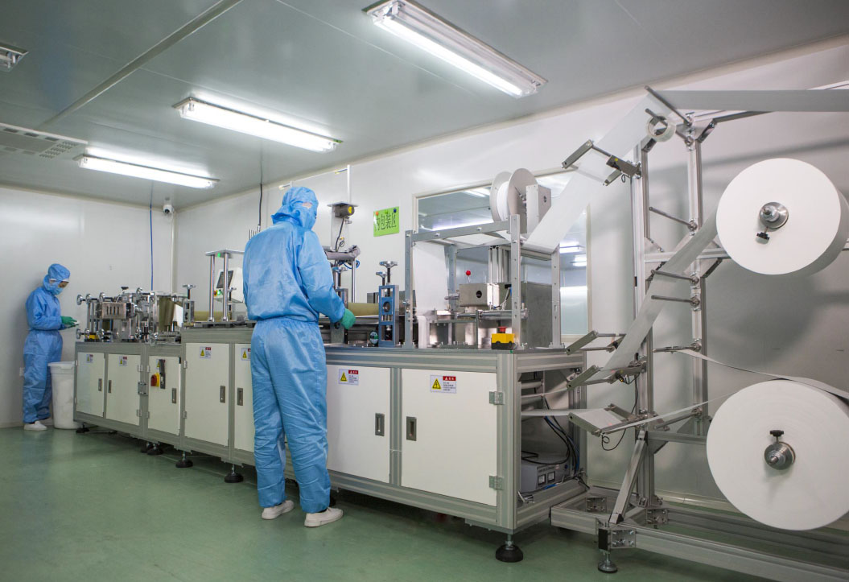
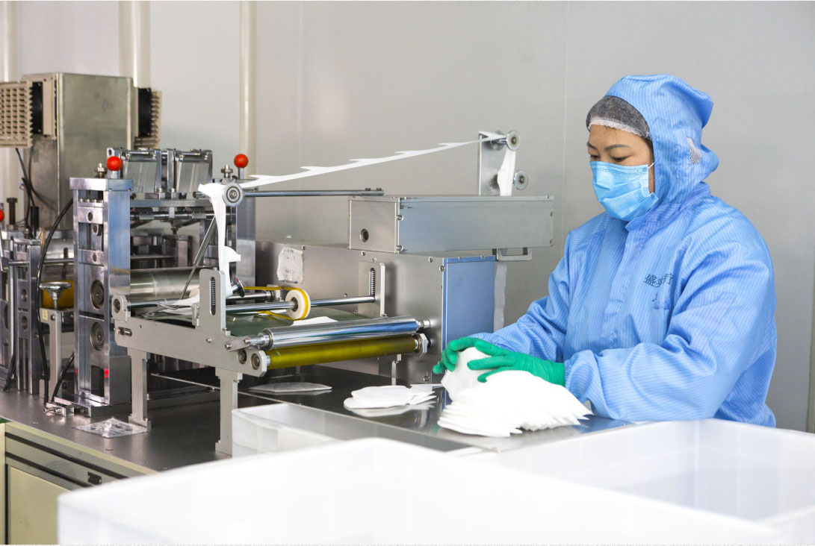
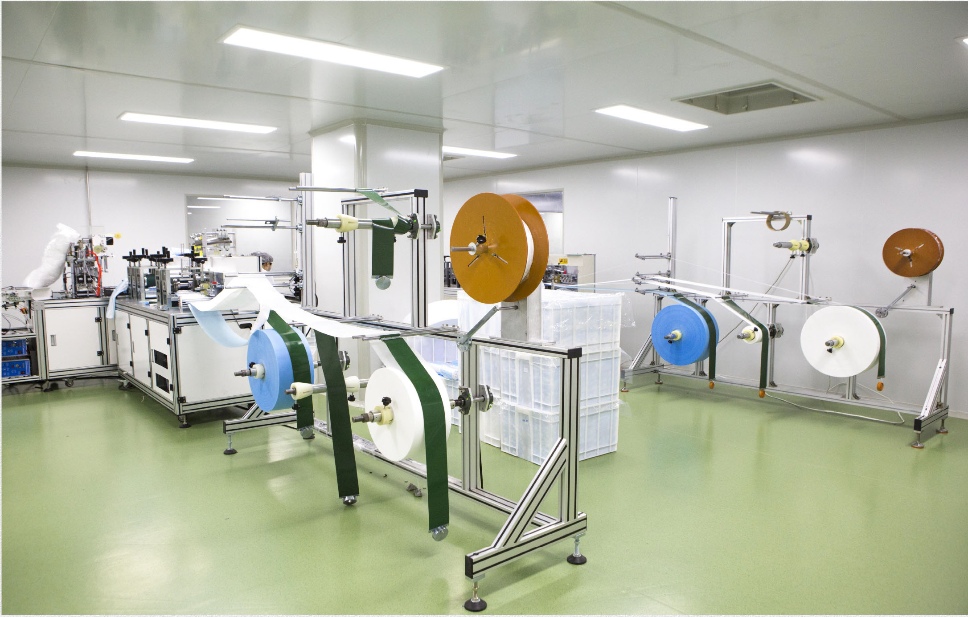
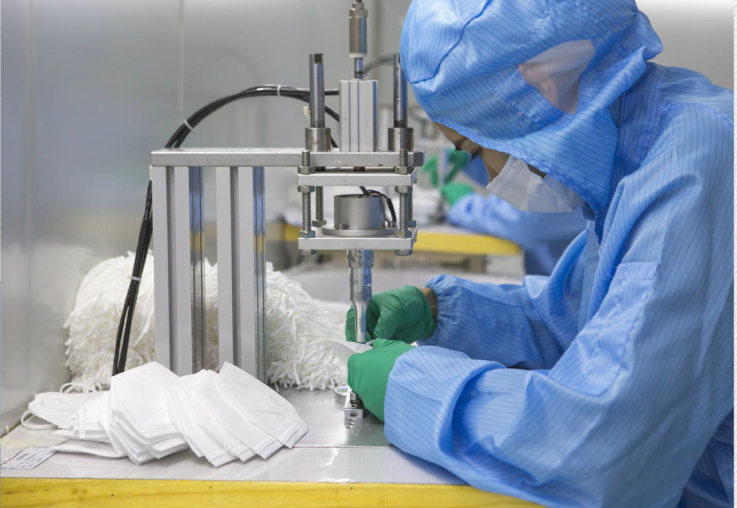
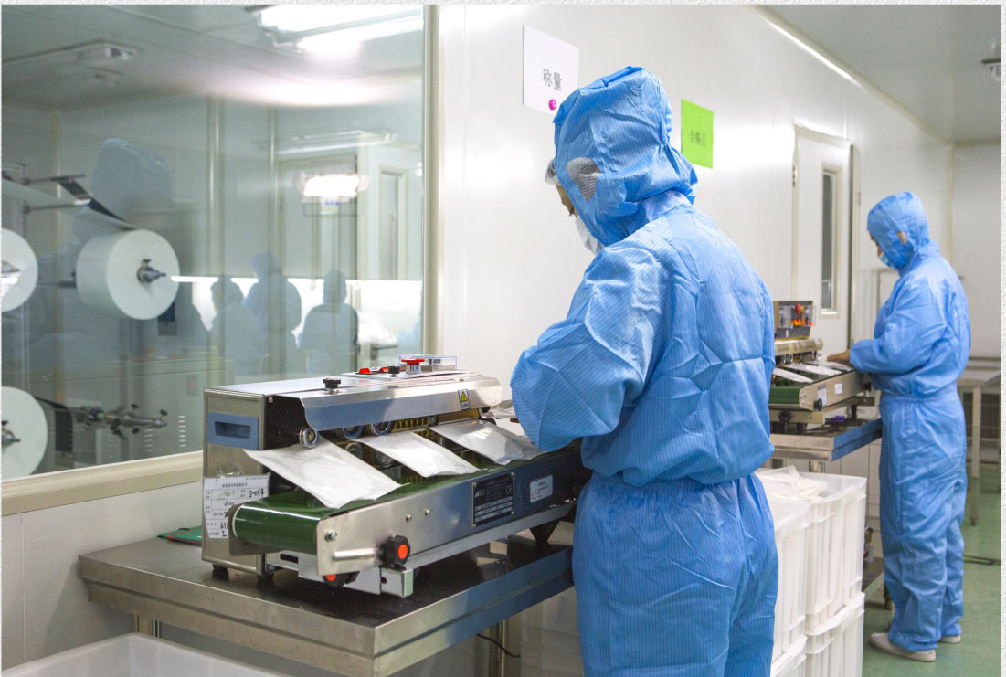
01
公司简介
COMPANY PROFILE
公司于2014年取得国内医用防护口罩医疗器械注册证，在多年生产销售过程中，不断引进先进生产和检验设备，建立了完善的质量管理体系，确保产品的安全性和有效性，为顾客提供了价值卓越的产品和服务。
The company obtained the domestic Registration Certificate For Medical Device (Medical Respirator Mask) in 2014. During the years of production and sales, it has continuously introduced advanced production and inspection equipment, established a perfect quality management system to ensure the safety and effectiveness of products and provide customers with excellent value products and services.

Slide 6
02
资质证照
国内证照
Qualification Certificate
PART TWO

Slide 7
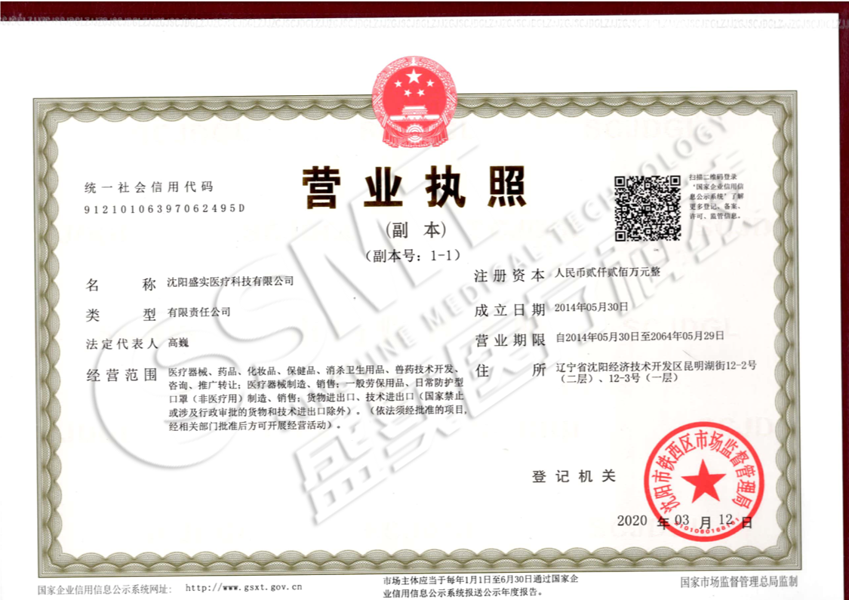
02
国内证照-营业执照
QUALIFICATION CERTIFICATE - Business License

Slide 8
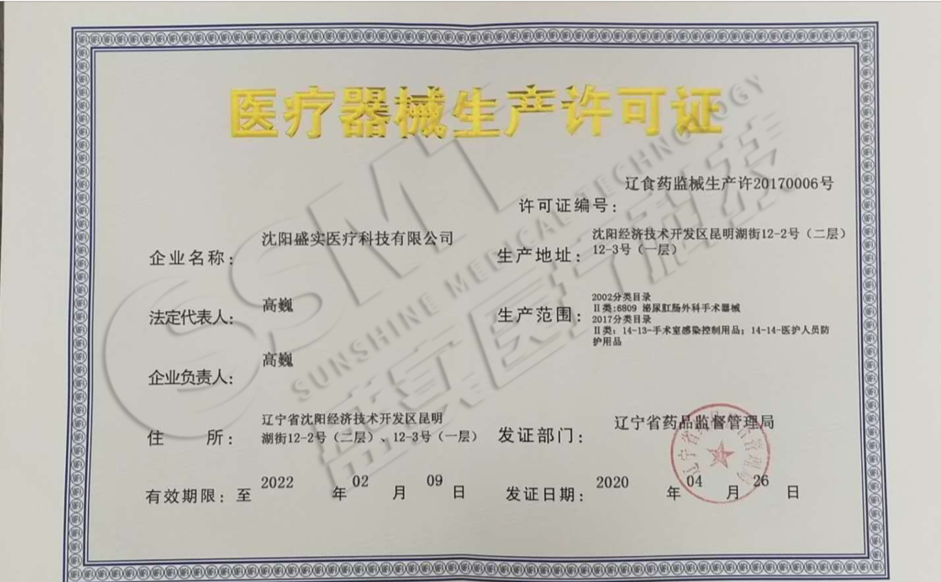
02
国内证照-生产许可证
QUALIFICATION CERTIFICATE - Production Enterpriser License of Medical Instrument

Slide 9
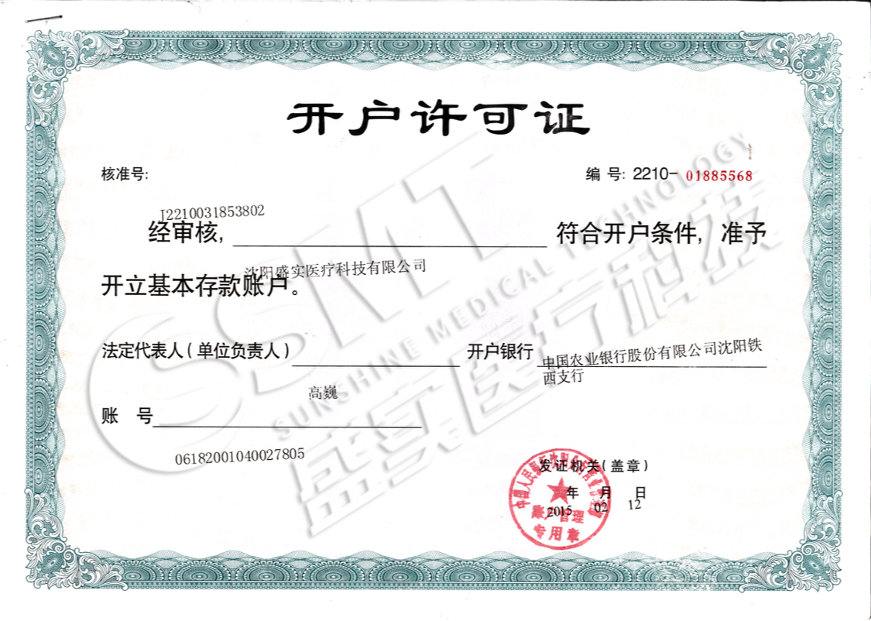
02
国内证照-开户许可证
QUALIFICATION CERTIFICATE - Account Opening License

Slide 10
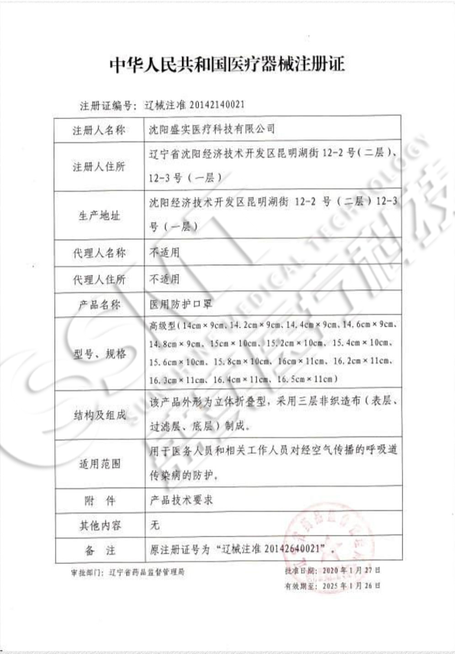
02
国内证照-医用防护口罩(无菌)医疗器械注册证
QUALIFICATION CERTIFICATE - Registration Certificate For Medical Device

Slide 11
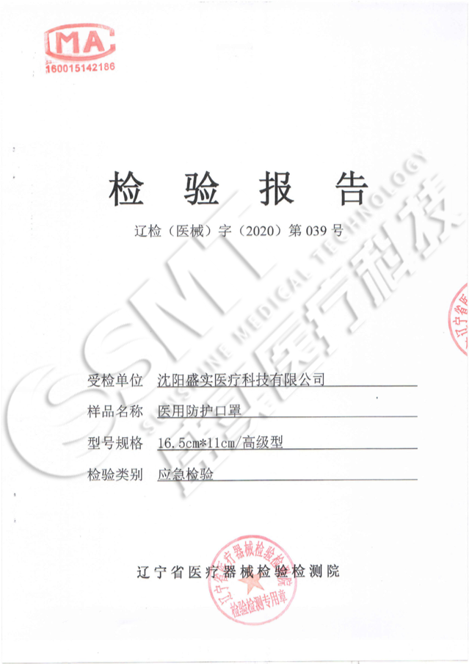
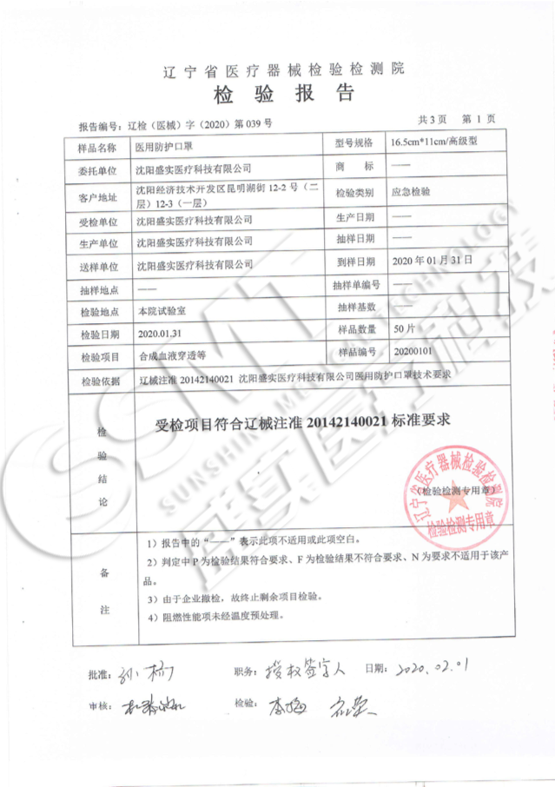
02
国内证照-医用防护口罩(无菌)省所检验报告
QUALIFICATION CERTIFICATE – Test Report

Slide 12
02
国内证照-国家防疫物资重点保障名单
QUALIFICATION CERTIFICATE – Enterprises for Epidemic Prevention & Control Guarantee
我公司位列国家防疫物资重点保障名单中
Our company is one of keynote enterprises for epidemic prevention and control guarantee.

Slide 13
03
资质证照
出口资质
Qualification Certificate
PART TWO

Slide 14
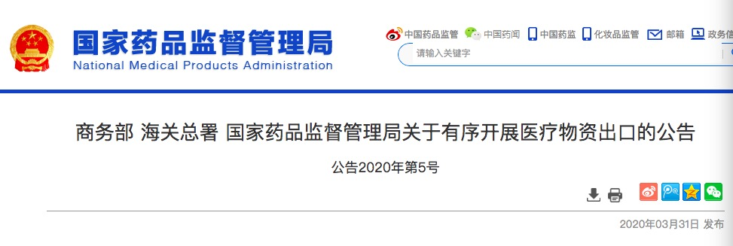
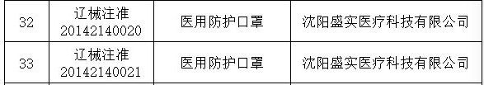
03
出口资质-国家出口防控物资白名单
我公司位列商务部海关总署和药监局三部门联合发布的医疗物资出口企业名录中
Our company was on the Export List of Medical Supplies according to the announcement of the Ministry of Commerce, the General Administration of Customs and the National Medical Products Administration on Conducting the Export of Medical Supplies in an Orderly Manner.

Slide 15
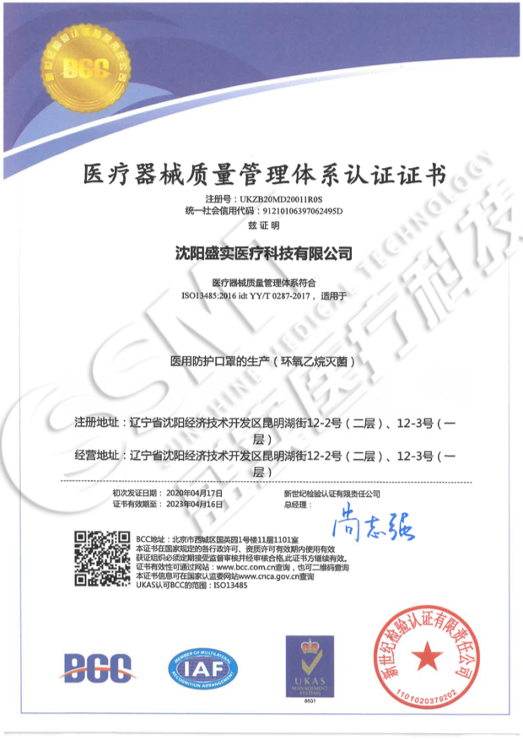
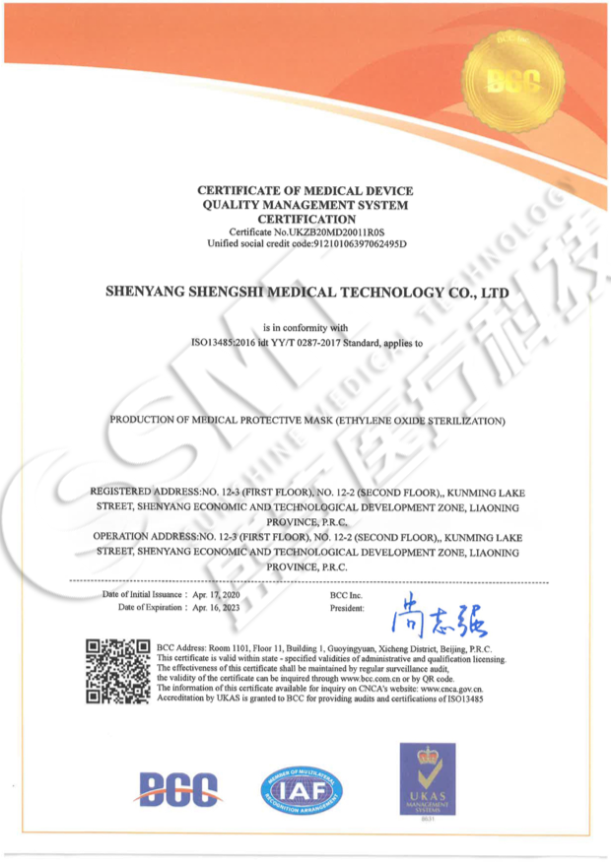
03
出口资质-ISO13485
QUALIFICATION CERTIFICATE – ISO13485

Slide 16
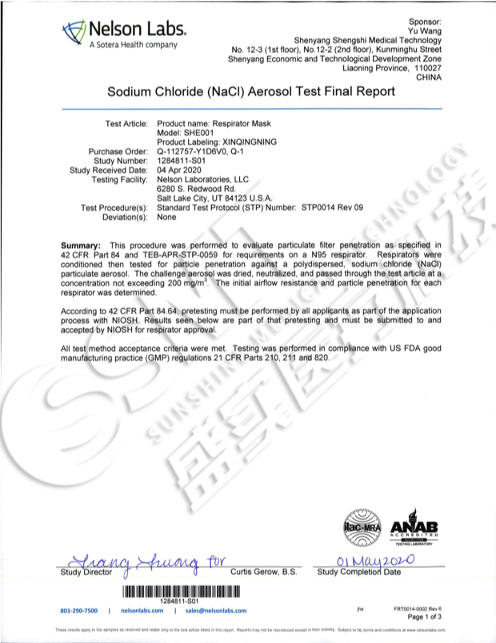
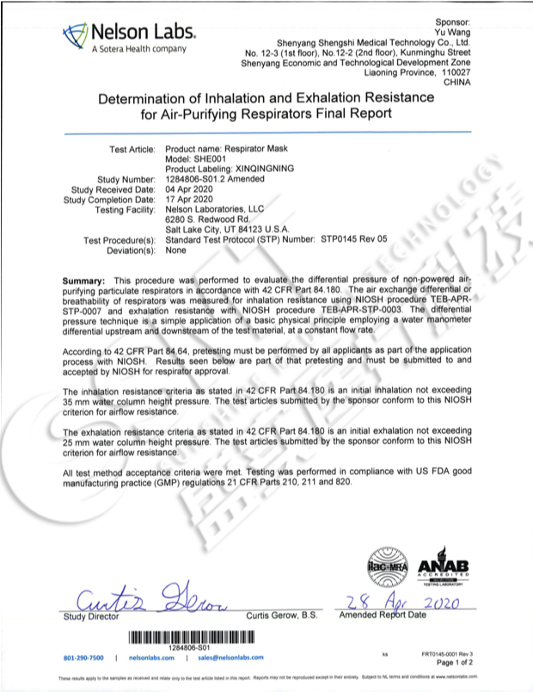
03
出口资质-NELSON检测报告
QUALIFICATION CERTIFICATE – NELSON

Slide 17
04
产品及包装展示
Products & Packaging
PART TWO

Slide 18
04
产品展示
PRODUCT INFO
医用防护口罩(无菌)

Slide 19
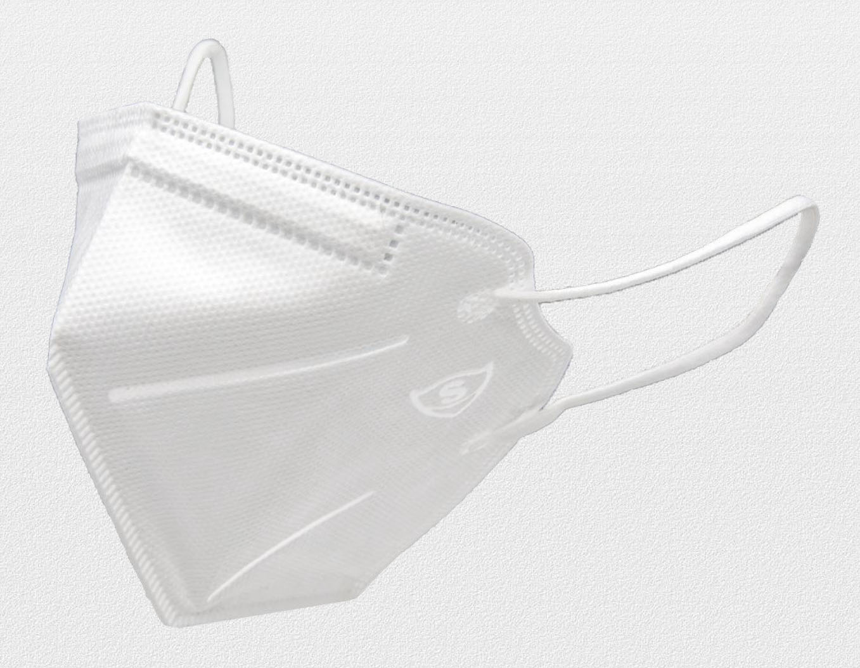
04
产品展示-医用防护口罩(无菌)
PRODUCT INFO
N95滤料级别（对非油性颗粒）过滤效率达95%以上
执行标准：GB 19083-2010
N95filter material level (Filters at least 95% of airborne particles. No resistant to oil.) Executive Standard GB 19083-2010
口罩外形为立体折叠型，外层为无纺布层，防水、抗湿；起到初步阻隔和过滤作用。
无菌
It is a three-dimensional folding mask, which the outer layer is a non-woven fabrics layer, which is waterproof and moisture-resistant, plays the role of preliminary barrier and filtering.
中层为熔喷布过滤层，有效阻隔细菌、飞沫、血液、体液、分泌物等颗粒物。
The middle layer is a melt-blown fabrics filter layer, which effectively blocks particles such as bacteria, droplets, blood, body fluids, and secretions.
规格：16.5cm * 11cm
内层为无纺布层，无毒无刺激，佩戴舒适。
The inner layer is a non-woven fabric layer, which is non-toxic, non-irritating and comfortable to wear.

Slide 20
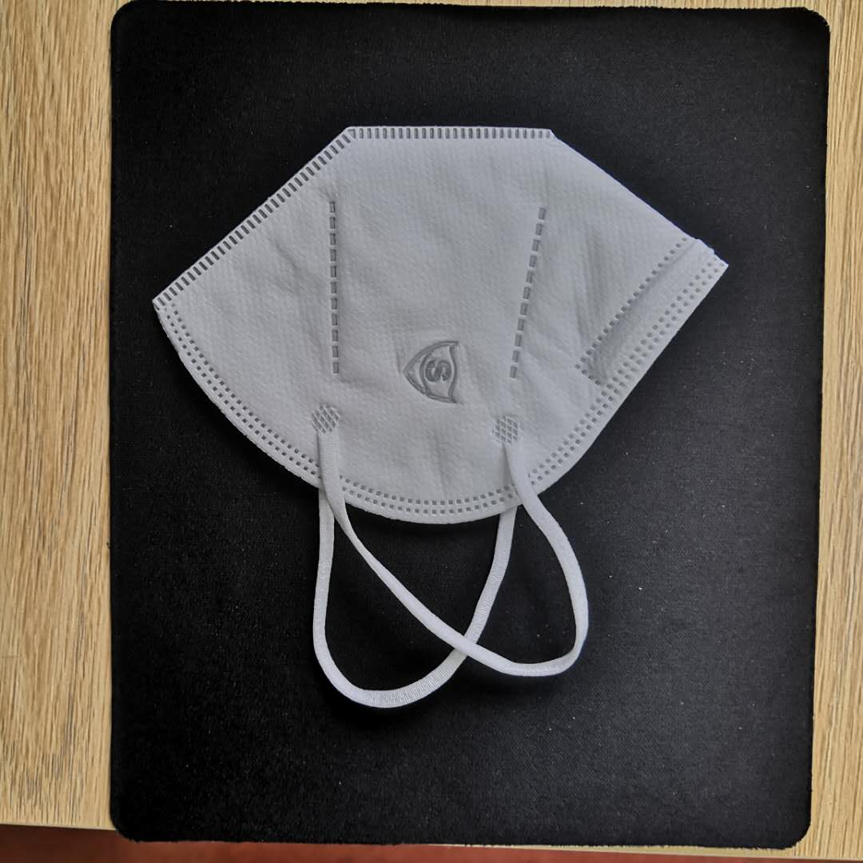
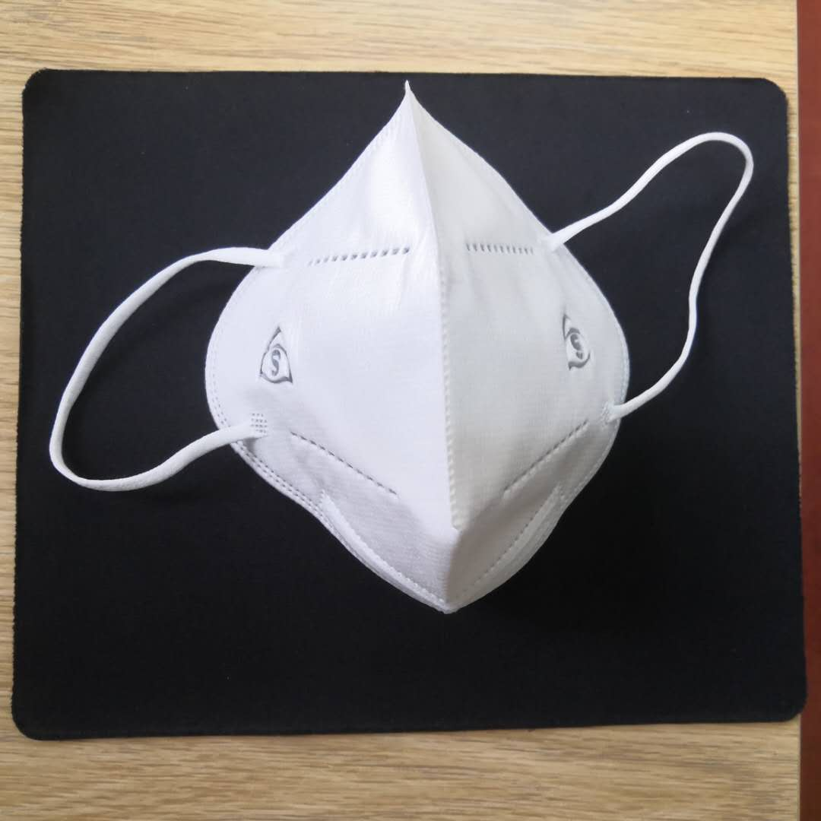
04
产品展示-医用防护口罩(无菌)-实拍图片
PRODUCTS - Real Shot Pictures

Slide 21
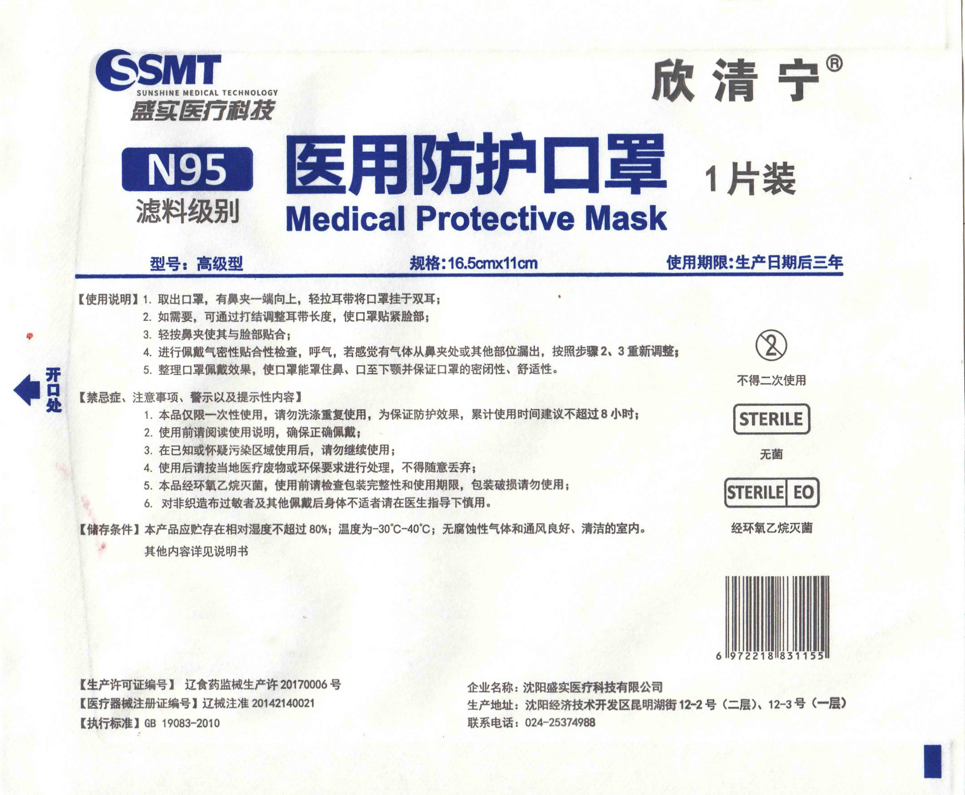
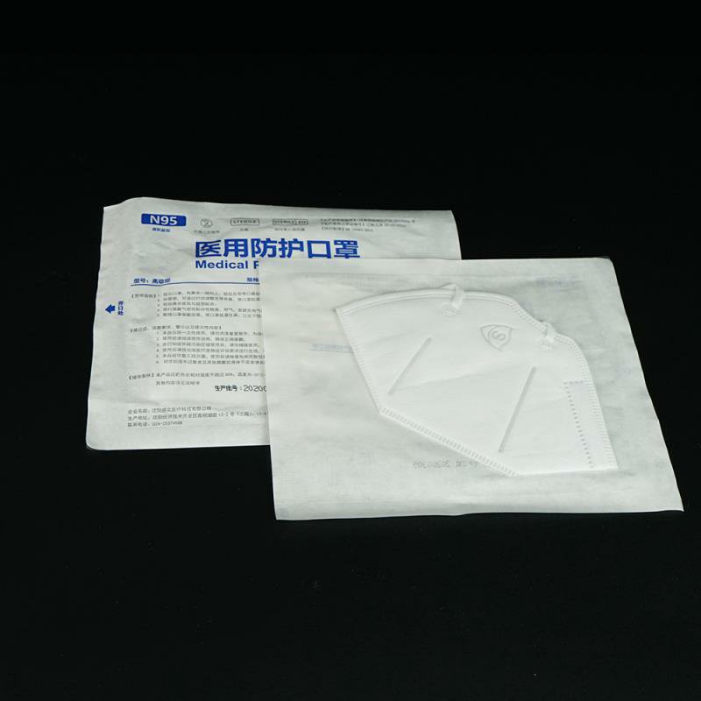
04
包装展示-医用防护口罩(无菌)-内包装
PACKAGE – Inner Packing
纸塑袋
材质： 60g国产水胶纸 +5丝pet/pe复合膜
尺寸： 150mm*180mm
每包1片
1 pcs/ inner packing (Paper-Poly Pouch)
SIZE: 150mm*180mm

Slide 22
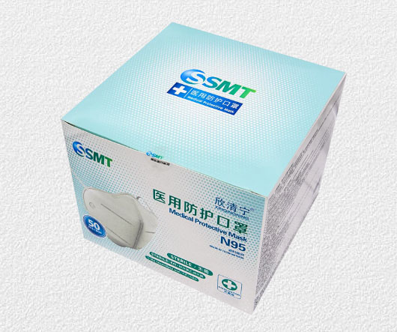
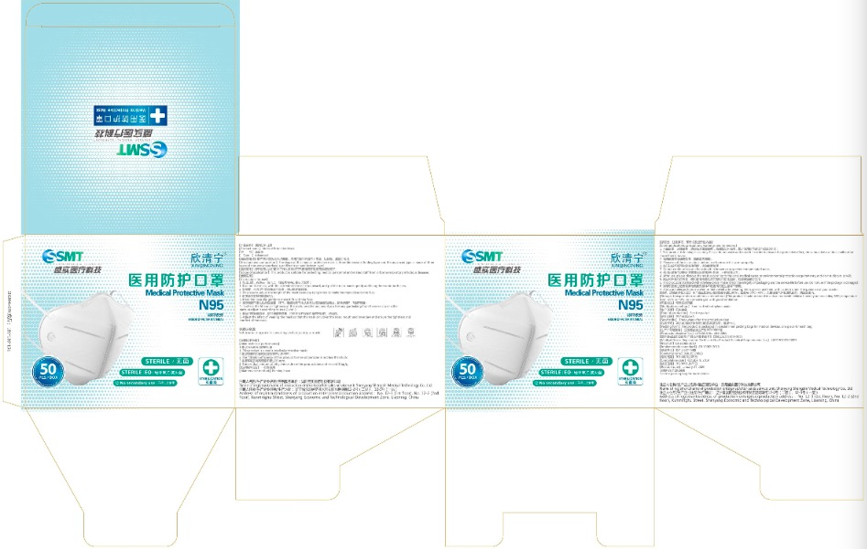
04
包装展示-医用防护口罩(无菌)-中包装
PACKAGE – Middle Box
小盒
材质： 350g白卡 +4色
尺寸： 186mm*186mm*154mm
每盒50片
50 pcs/ box
SIZE: 186mm*186mm*154mm

Slide 23
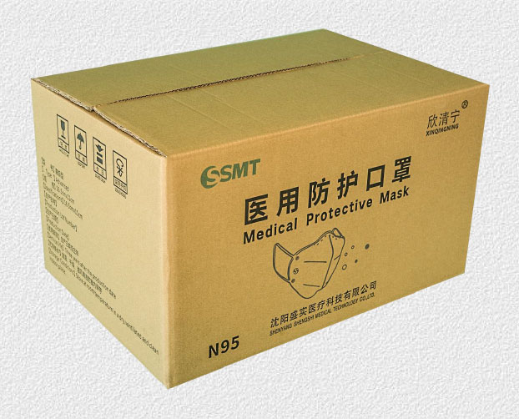
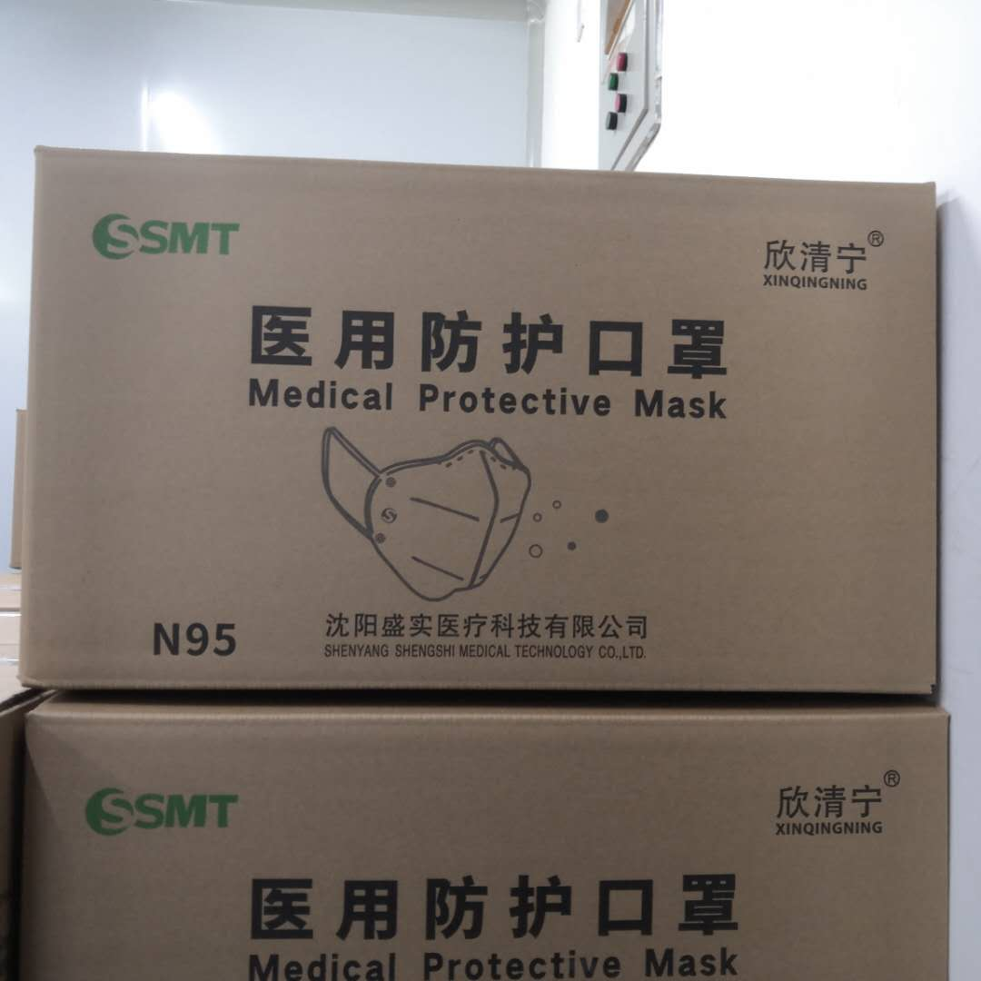
04
包装展示-医用防护口罩(无菌)-大箱
PACKAGE - Packing Carton
大箱
材质面160g/高强 140g/里纸140g
尺寸： 573mm*387mm*328mm
每箱600片
600 pcs/ carton
SIZE: 573mm*387mm*328mm

Slide 24

2020
THANK YOU
感谢您

